Slide 1
Getting to Yes: Overcoming Barriers to Enhanced Screening Programs
AHFSA Annual Conference
Background Screening Interest Track
August 21-23, 2017
Ernie Baumann, CNA; Alem Ghebrezghi, DC; Brenda Dreher, KS; Steve Gobbo, MI; David Ostrander, GA; Melanie Madore, MO

Slide 2
Getting to Yes: Overcoming Barriers to More Robust Background Screening
Objective: This session will illustrate how States overcame barriers to implement statewide background screening programs for LTC.
Questions and discussion: Our conference goal is dialog. In this session, attendees are encouraged to comment, ask questions, describe barriers that exist in their State, and exchange information.

Slide 3
Getting to Yes: Topics and States
KS – Negotiating legislation and agencies
DC – Success through creativity
MI – Building on prior experience
MO – Making lemonade from lemons
GA – Progress with a voluntary program
Q and A with States

Slide 4
Getting to Yes: Kansas (1 of 2)
Brenda Dreher, Director, Health Occupations Credentialing
Barrier when grant started was getting agency leadership attention/priority
Met with key stakeholders and Secretary
Persistence in management meetings
Used TA to show financial model
Held a demonstration of prototype BCS
Secretary sold it to Governor’s office
Current barrier is getting legislation passed
Getting right level of personnel from other agencies
Internal: KBI had provided legislative language, then opposed. Participated in bi-weekly planning and status meetings.
Other agencies involved (Home Health)
12 external stakeholder meetings with no objections were followed by a letter of opposition

Slide 5
Getting to Yes: Kansas (2 of 2)
Agency Chief Counsel read the grant and made concessions to the Attorney General and KBI
Attorney General and Director of KBI got on board after concessions, persistent meetings
Current Status and Plans
Optimistic about legislation for 2018
In interim doing development using TA BCS
Will implement what is authorized
Get providers and State staff familiar with system and process.
Suggestions/Advice to new States

Slide 6
Success through Creativity: District of Columbia
Alem Ghebrezghi, Program Manager, Criminal Background Check Program, District of Columbia DOH
Environment/barriers when grant started
MPD would not allow more FP machines or provide electronic CHRI
Legislature would not pass required FP authorization
What has happened:
Contracted for channeling service to bypass MPD
Used PL111-148 NBCP and local law to get FBI CHRI
Other considerations and future:
Continuation of program after grant – DC assumed responsibility
Lots of additional capacity
Suggestions/Advice to new States

Slide 7
Success by Building on Experience: Michigan
Steve Gobbo, Deputy Director, Bureau of Community & Health Systems, Michigan Department of Licensing and Regulatory Affairs
Environment when grant started
Pilot project (2004-07) had put successful program in place
Had support from State executives & legislature
Legislative compromise: Grandfathered current employees in covered facilities
What has happened:
Used NBCP to enhance IT efficiency and study integration of personal care workers
IT integration completed – add-ons for health professional licensing & ACF/Child Care/CCDF requirements; electronic CHRI; live scan; federal rap back (pending); study of new innovations (Natural Language Learning)
Grant specified a PCW study (published), and a pilot program (recently authorized)
What are current or anticipated barriers:
DHHS regulating PCWs
2013 Grant extended but now ended, direct relationship between agencies ended
Suggestions/Advice to new States

Slide 8
Making Lemonade from Lemons: Missouri
Melanie Madore, Bureau Chief, Family Care Safety Registry
Environment/barriers when grant started
Support from Missouri State Highway Patrol and Missouri Healthcare Association
Opposition to enabling legislation from a variety of other provider associations, with major objections related to cost and hindering business (potential slowdown of hiring process and diminished applicant pool)
Ambivalent political environment
What we tried
Worked with stakeholders (provider associations)
Numerous changes to proposed statutory language
Worked on RFP language for fingerprint provider to incorporate wanted items such as increase in number of FP sites, more convenient days/hours, decrease in miles traveled to get to sites
Worked to reduce potential fees and increase convenience - grandfathered existing employees, transfer from one employer to another without paying for new fingerprints (within limits), eventual incorporation of RAP-back

Slide 9
Making Lemonade from Lemons: Missouri
What we accomplished
Developed software capabilities: Background Screening and Employment Eligibility System
Web-based screening system, includes name-based criminal history and six other State registries
Handling roughly a half million screenings annually
Accepts internet registrations from the public and screening requests from providers with secure user accounts
Allows staff entry of paper-based registration applications and paper/telephone-based screening requests
Automatically screens for all known aliases and dates of birth within +/- 2 years
Tracks appeals (accurate transfer of information) and Good Cause Waivers (rehabilitation/work waiver info)
Component to incorporate fingerprint results, other registry information, other State data, eligibility determinations and employment decision data is ready and waiting for enabling legislation
Current/anticipated barriers:
No authorization to share out-of-State or federal criminal info we may hear about anecdotally
Missouri is bordered by eight States, so the limitations of Missouri-only info are obvious
Ongoing political ambivalence
Suggestions/Advice to new States
Work with stakeholders from the beginning, as they can make (or break) your program.
Seek executive and legislative support early in the process.

Slide 10
Progress With a Voluntary Program: Georgia
David Ostrander, Inspector General
Environment/barriers when grant started
Had support from GBI
Had opposition to legislation
Had experience in conducting background checks
What has happened:
Implemented voluntary program - number of facilities participating
Developed software capabilities
What are current or anticipated barriers:
Legislation
Fingerprinting costs

Slide 11
Progress With a Voluntary Program: Georgia
Suggestions/Advice to new States
Support from Executive Leadership
Support from Advocacy Groups
Being able to modify your background check system
Example: Build a public registry at no cost to your State
As a grantee State, you have six (6) years to implement legislation, a background check computer system, etc.

Slide 12
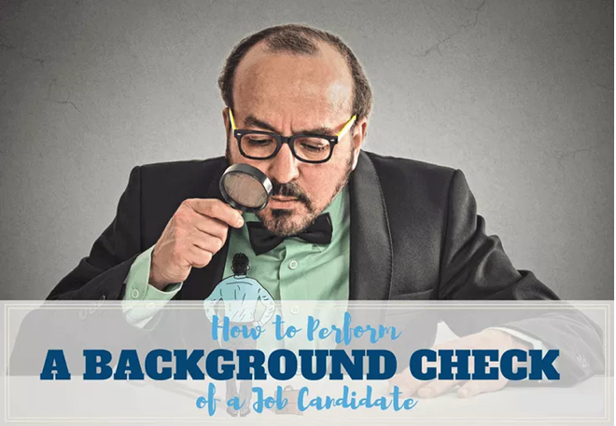
Questions from States?

