Slide 1
Introduction to the National Background Check Program: Statewide Pre-Employment Screening for LTC Workers
AHFSA Annual Conference
Background Screening Interest Track
August 21-23, 2017
James Joslin, OK; Alex Netten, ME; Meghan Shears, WV

Slide 2
Introduction to the National Background Check Program: Statewide Pre-employment Screening for LTC Workers
Objective: This session will convey the status of the Grant Program and the National Forum, and introduce State pre-employment screening program activities for the states of Maine and West Virginia.
Questions from interested States: Our conference goal is dialog. In this session, representatives from interested States are encouraged to ask questions; describe their challenges for efficiency and equity; and exchange information.

Slide 3
Status of the CMS Grant Program and the National Forum for Background Checks
CMS Grant Program Status
National Forum Status
History/origination, Vision, Mission
Membership
Activities & Initiatives
Task 1: Establish Communication Infrastructure
Task 2: Develop Library
Task 3: Expand Data Sharing Among States
Task 4: Develop contract templates or a multi-State contract vehicle for technical services
Task 5: Advocacy for more effective, efficient, and equitable background checks to protect vulnerable populations
Task 6: Identify, Organize, and Participate in Forum meetings and other relevant conferences
CNA Support
Future Forum Plans

Slide 4
Maine: Alex Netten
How we decided to pursue a grant
Maine is very rural
Oldest state in the country
Aged 65+:
2010 15.9%
2016 19.4%
No BGC standards in state
2011 survey
Criminal history 73%
Professional licensing 37%
OIG 48%

Slide 5
Maine: Alex Netten
How we decided to pursue a grant
10 different departmentally separate data sources
Division of Licensing and Certification
Certified Nurse Aide Registry
Direct Care Worker Registry
Facility Licensing Management Systems
Office of Aging and Disability Services
Adult Abuse Registry
Office of Child and Family Services
Child Abuse Registry
Maine State Bureau of Identification
Sex Offender Registry
Criminal History Record Information System
Automated Fingerprint Identification System
Office of Professional and Financial Regulation
Agency Licensing and Management System
AG’s Office, Division of Audit, Office of Program Integrity
Maine’s Excluded Providers List
Maine decided it needed help to identify the efficient, effective, and economical procedures necessary to conduct background checks on prospective workers

Slide 6
Maine: Alex Netten
Grant Initiatives
Authorizing legislation included childcare as part of mandated users of Maine Background Check Center (MBCC)
Protect growing elderly population and children while at the same time expand workforce opportunities

Slide 7
West Virginia: Meghan Shears
How we decided to pursue a grant
Grant would give WV the ability to begin standardizing background check requirements
Grant Initiatives
Streamline prescreening/background check process
Grow partnership with the WV State Police
Rap Back
Standardize background check requirements within LTC

Slide 8
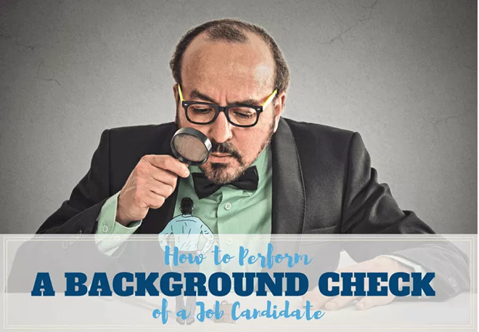
Questions from States?

