Slide 1
Lessons Learned from the Frontline: Prevention and Control of MDROs in Long-Term Care Facilities
Belinda Ostrowsky, MD, MPH
Field Medical Officer, NY
Prevention and Response Branch
CDC Division of Healthcare Quality Promotion

Slide 2
Speaker Disclosures
  No conflicts to disclose
  The content of this presentation reflects my opinion and does not necessarily reflect the official position of the CDC or NYSDOH
n.b.: No facility or patient names are used (cases composites)
Pictures are only illustrative (collected as part of visits)

Slide 3
Objectives
Review Multi-Drug Resistant Organisms (MDROs) in LTCFs
Review CDC Containment Strategy for (MDROs)
Identify infection prevention and control (IPC) challenges in LTCFs
Describe potential practical IPC solutions

Slide 4
Case Example
70 year old admitted from a long-term acute care hospital (LTACH) to nursing home
  Complicated hospital history including surgery, prolonged ICU stay, multiple courses of antibiotics
  Spent 5 weeks in the LTACH
On transfer, has tracheostomy, PEG tube, indwelling urinary catheter and partially healing sacral pressure ulcer
One week later, on reviewing the chart, you find results of a culture sent from tracheostomy secretions
Illustrative case courtesy of K. Slifka Jacobs, CDC

Slide 5
Case Example, continued
Drug | Result
Amikacin | Intermediate
Ampicillin | Resistant
Amp/Sulbactam | Resistant
Aztreonam | Resistant
Cefazolin | Resistant
Cefepime | Resistant
Ceftazidime | Resistant
Ceftriaxone | Resistant
Cefuroxime | Resistant
Gentamicin | Resistant
Levofloxcin | Resistant
Meropenem | Resistant
Piperacillin/Tazobactam | Resistant
Tobramycin | Resistant
Trimethoprim/Sulfa | Resistant
  Tracheostomy aspirate culture grew Klebsiella pneumoniae, >10⁵ cfu
Notes:
Q: Raise your hand if you have seen results like this at your facility or a facility that you were visiting
Q: Raise hand if nursing home – keep your hand raised if you provide skilled nursing care/rehabilitation services at your facility
Raise your hand if you are at a nursing home that care for residents on ventilators

Slide 6
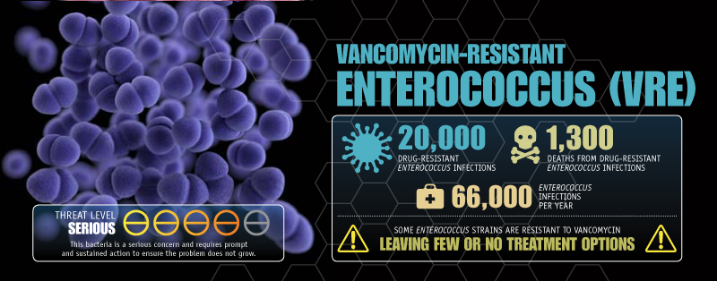
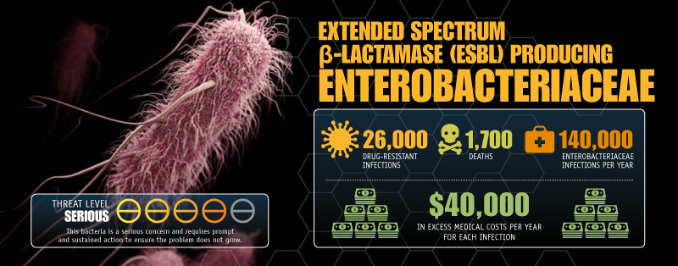
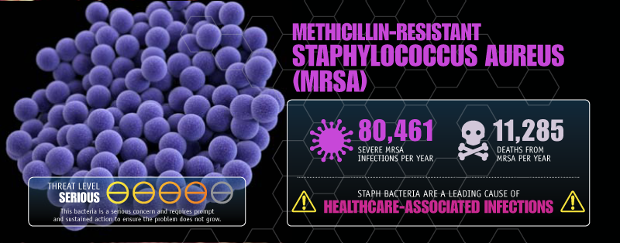
Notes:
Q: How many of you have had at least one patient or resident in your facility with at least one of these organisms?
Q: how many of you have NEVER seen a resident with one of these organisms?

Slide 7
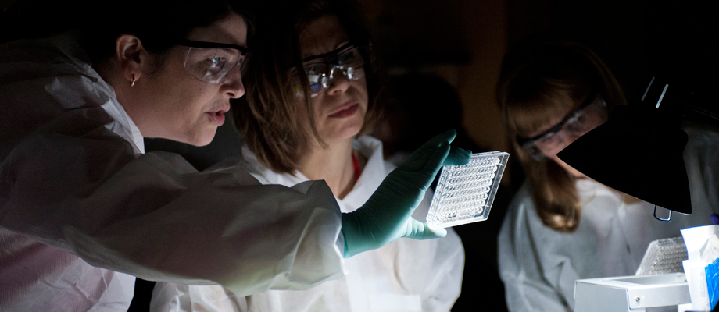
Carbapenem Resistant Enterobacteriaceae (CRE)
“Nightmare bacteria”

Slide 8
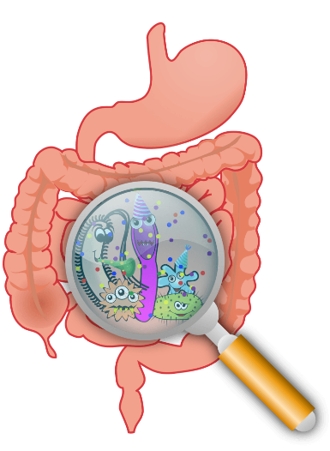
CRE are a public health threat
CRE cause invasive infections with high mortality (up to 40-50%)
– Urinary Tract Infections
– Bloodstream infections
– Wound infections
– Pneumonia

Slide 9


CRE are a public health threat
They cause invasive infections associated with high mortality rates
Carry resistance genes on mobile genetic elements that confer high levels of resistance
Leave limited to no therapeutic options
Facilitate spread

Slide 10
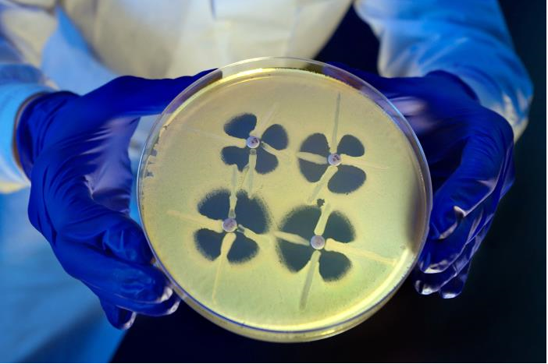
Carbapenem-resistant Enterobacteriaceae (CRE)
Multiple different mechanisms can cause resistance
  Carbapenemase-producing (CP-CRE)
    KPC – Klebsiella pneumoniae carbapenemase (most common in U.S.)
    NDM – New Delhi Metallo-β-lactamase
    VIM – Verona Integron-encoded Metallo- β -lactamase
    OXA – Oxacillinase-48-type carbapenemase
    IMP – Imipenemase Metallo- β -lactamase
  Non-carbapenemase-producing (non-CP-CRE)
Notes:
Q: How many have seen an organism with one of these mechanisms? NDM? VIM? OXA? At your facility?

Slide 11
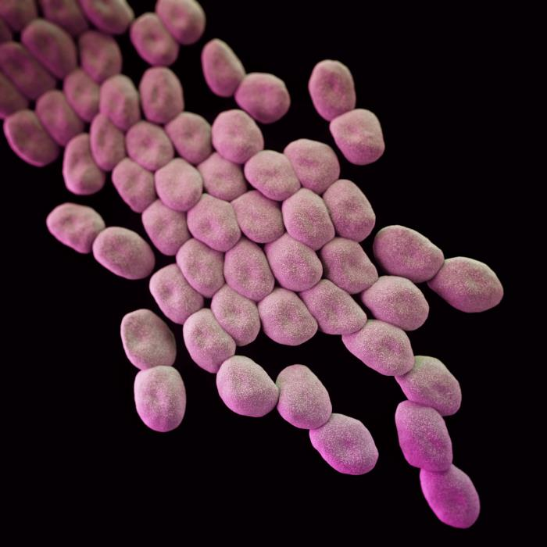
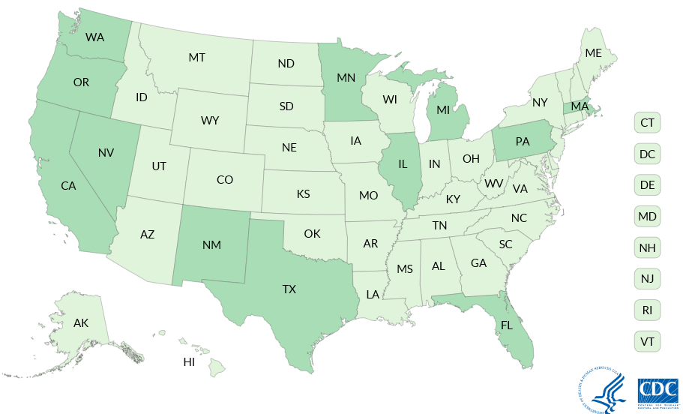
Carbapenemases in other Gram negative bacteria
Carbapenem-Producing Organisms (CPOs)
Proteus mirabilis, Providencia rettgeri, Citrobacter freundii
Number of isolates, by year of specimen collection
Number of isolates
Pseudomonas aeruginosa
VIM: 86 patients,
12 states
Acinetobacter baumannii

Slide 12
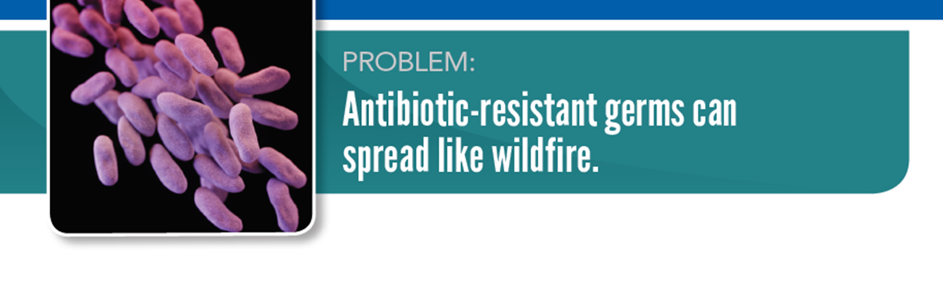
CPOs are a public health threat
They cause invasive infections associated with high mortality rates
Carry resistance genes on mobile genetic elements that confer high levels of resistance
CRE have spread throughout the United states and other countries and have the potential to spread more widely

Slide 13
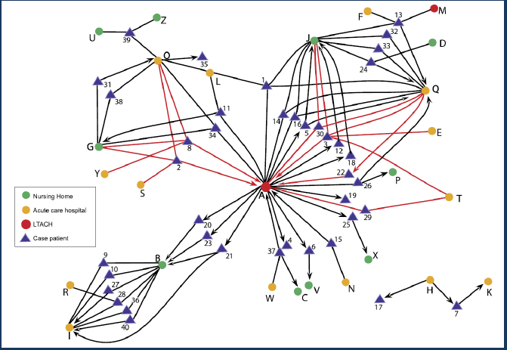
Healthcare networks driving outbreaks:
Findings from public health investigations
  Post-acute care facilities with longer length of stay and high acuity of care (e.g., ventilator services, IV therapy, wound care) expand the burden of resistance within a region
  Gaps in IPC program infrastructure and practices can augment this problem
Won SY et al. Clin Infect Dis. 2011;53(6):532-540.

Slide 14
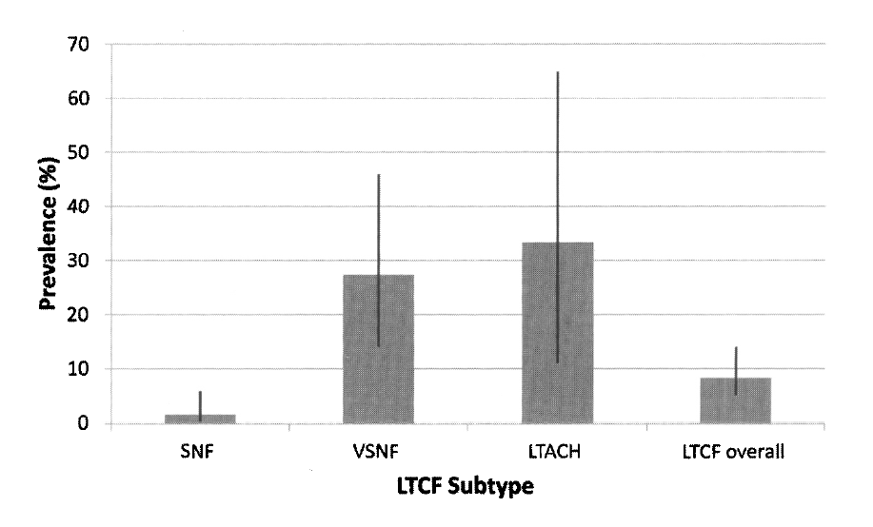
Carriage of CP-CRE (Klebsiella pneumoniae) among Hospitalized patients admitted from Post-acute/Long-term care, 2012
Average Prevalence and 95% confidence limits
33.3%
27.3%
8.3%
1.5%
Prabakar, Lin, McNally et al. Infect Control Hosp Epi 2012,33:12

Slide 15
Older adults are at high risk for infections with MDROs

Slide 16
Risk Factors for colonization with MDROs
Indwelling medical device (urinary catheter, PEG tube, trach, central line)
Lower functional status
Presence of wounds or decubitus ulcers
Antibiotic use in prior 3 months
Fluoroquinolone use
History of hospitalization
Older age
Comorbid medical conditions
Mody et al, J Am Geriatr Soc, 2007
Cassone, Mody, Curr Geriatr Rep, 2015

Slide 17

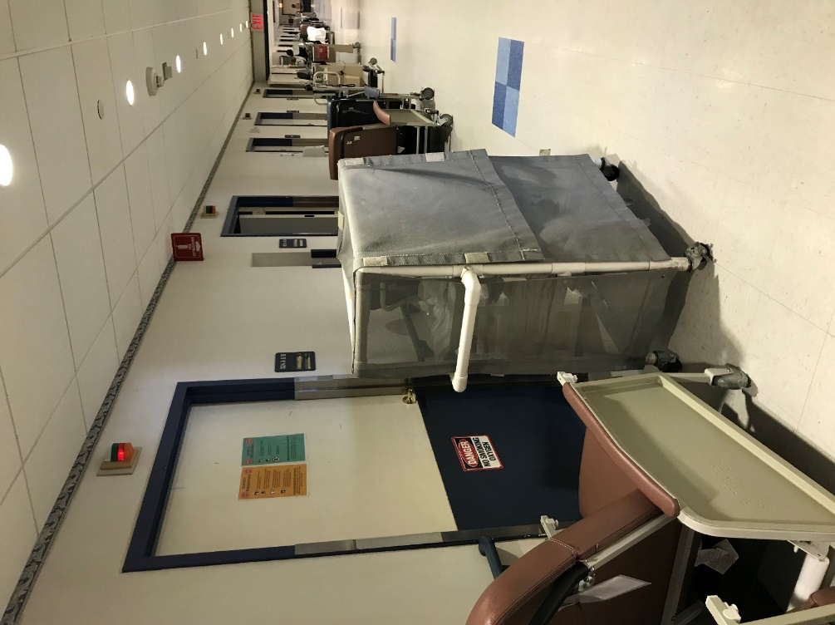
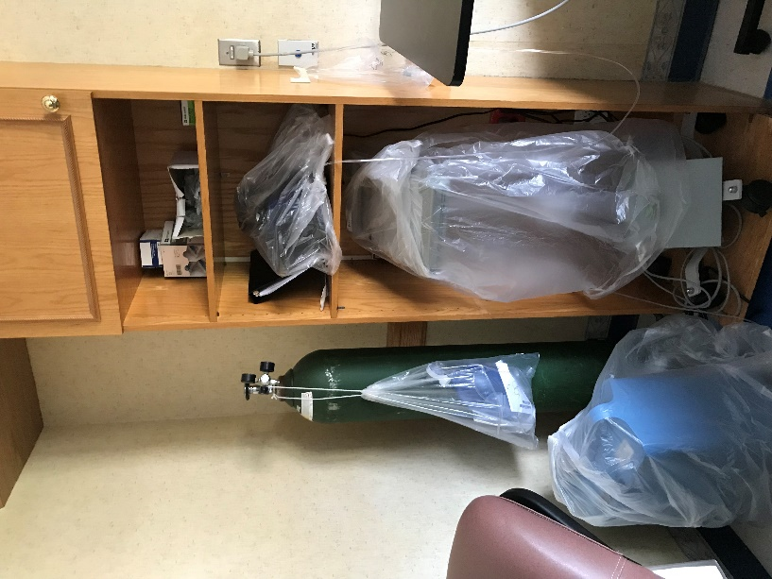
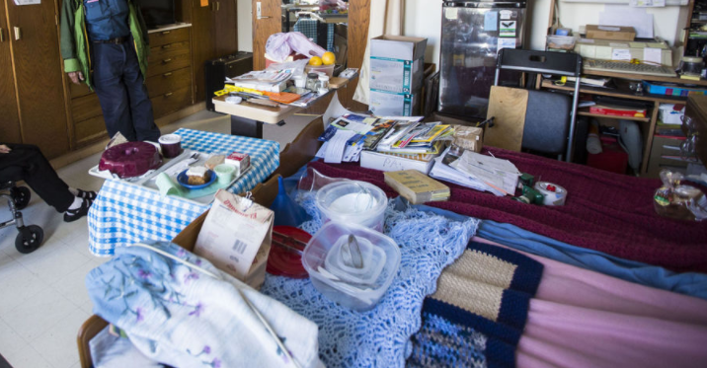
Nursing home setting provides opportunity for transmission

Slide 18

Candida auris

Slide 19

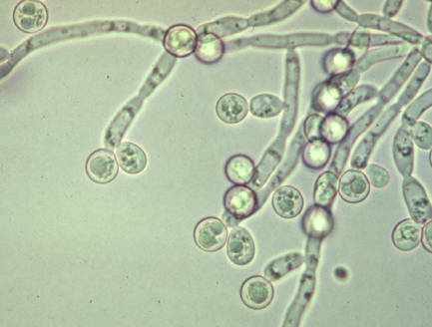
Candida can cause serious infections
Candidemia is the most common HAI bloodstream infection
30% mortality
Risk factors include:
  Broad-spectrum antibiotic use
  Central venous catheters
  Immune compromise

Slide 20
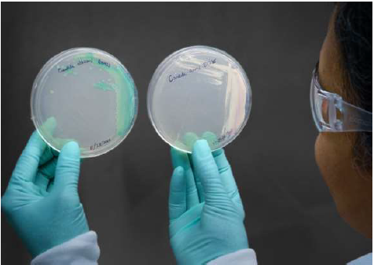
Candida auris presents new challenges
Often misidentified

Slide 21
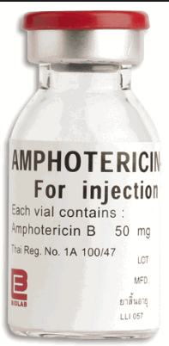

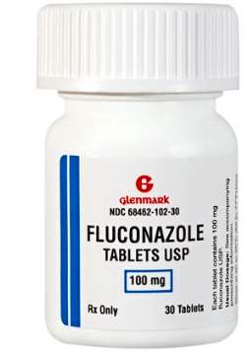
Candida auris presents new challenges
Often misidentified
Resistant to antifungal drugs
Polyenes
Azoles
Echinocandins
30% resistant
90% resistant
3% resistant

Slide 22
Candida auris presents new challenges
Often misidentified
Resistant to antifungal drugs
Causes invasive infections with high mortality

Slide 23

Candida auris Colonizes Skin and Other Body Sites
Colonization poses a risk for:
Invasive infection
Transmission to others

Slide 24
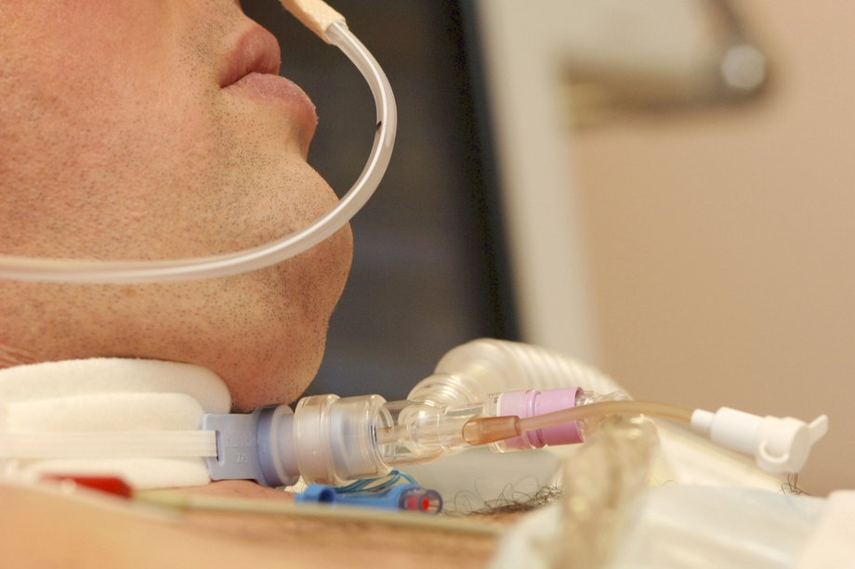
Risk Factors for C. auris
Older age
Multiple healthcare stays (post-acute and long term)
Prolonged healthcare stay
Taking antibiotics and antifungals
Tracheostomy
Ventilator
Feeding tubes
Central lines

Slide 25
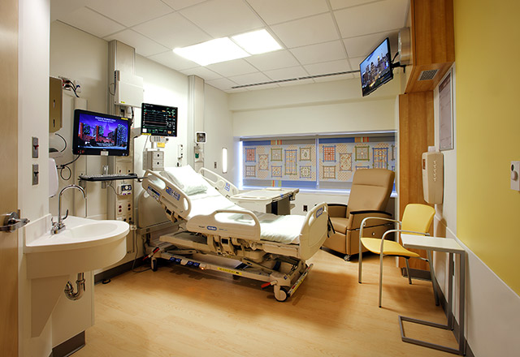
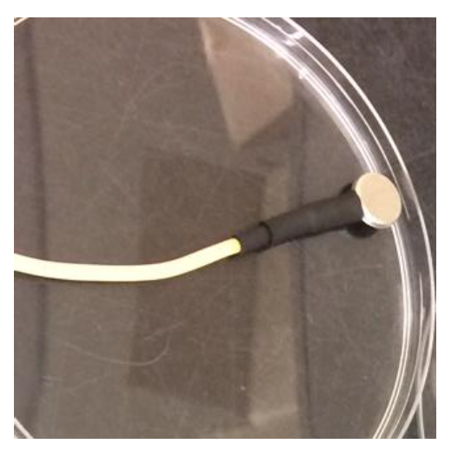
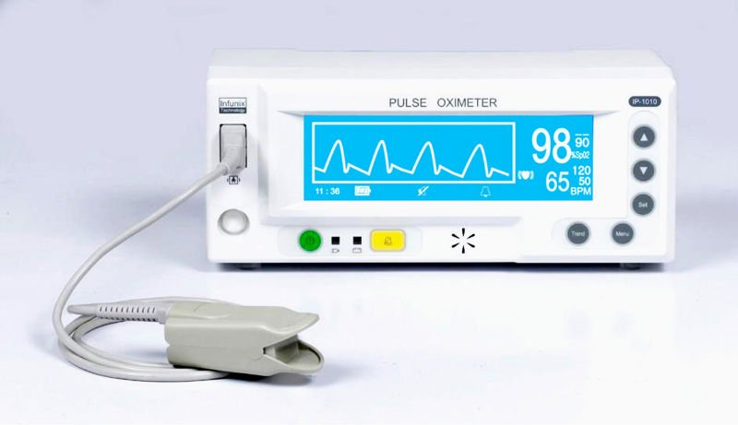
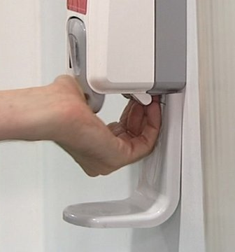

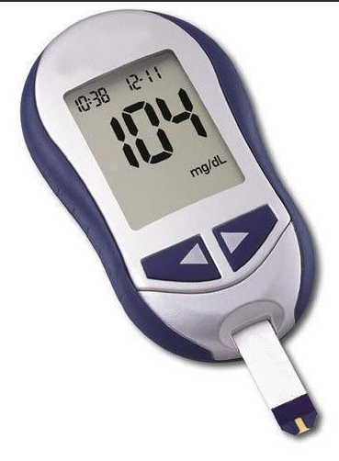
Candida auris colonizes the environment
Welsh R, J Clin Micro. 2017;55(10):2996-3005
E. Adams et al. ID WeeK Poster, October 2018
https://5.imimg.com

Slide 26
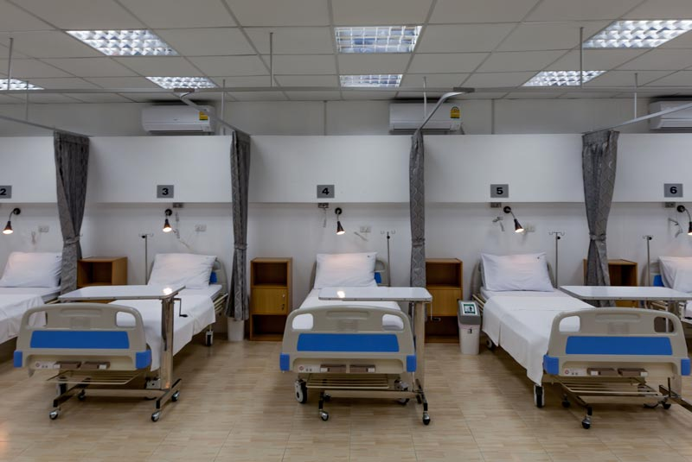
Candida auris presents new challenges
Often misidentified
Resistant to antifungal drugs
Causes invasive infections with high mortality
Can cause outbreaks in healthcare settings
All the makings of a fungal superbug!

Slide 27
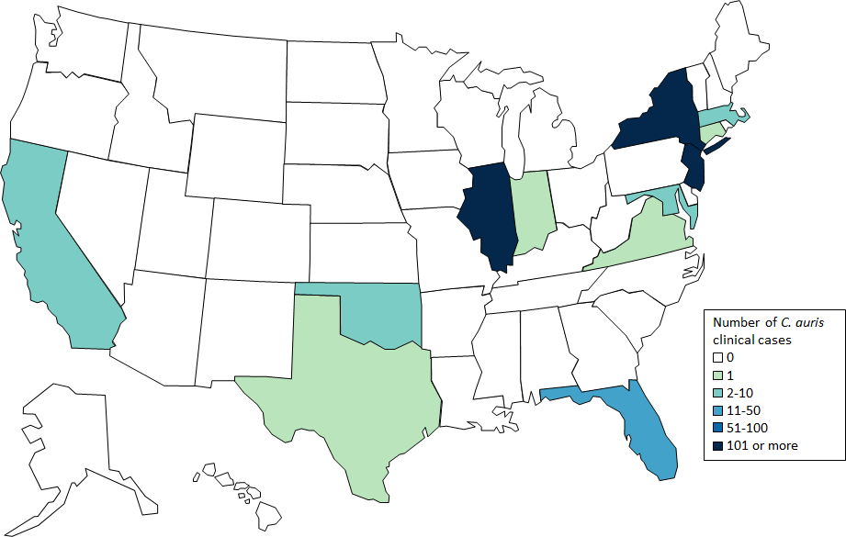
C. auris in New York
As of May 15, 2019:
  330 clinical cases
  462 surveillance cases
    39 double counted*
  Three “pan-resistant” cases
  * colonization to infection
CDC website cited 6/25/19: https://www.cdc.gov/fungal/candida-auris/tracking-c-auris.html
NYSDOH website cited 6/25/19: https://health.ny.gov/diseases/communicable/c_auris/

Slide 28
Affected Facilities
NYS facilities that have had a patient with C. auris in the
90 days prior to patient diagnosis to the present
Facility Type | # of Facilities Affected
Hospitals | 58
Nursing Homes & Rehabs | 103
LTACH | 1
Hospice | 2
Total | 164
Skilled nursing facilities (SNFs) caring for ventilated patient (vSNF) are disproportionately affected compared to other SNF (C. auris Colonization Rate: 7.0 % vs. 0.7 %)*
*E. Adams et al. ID Week Poster, October 2018

Slide 29
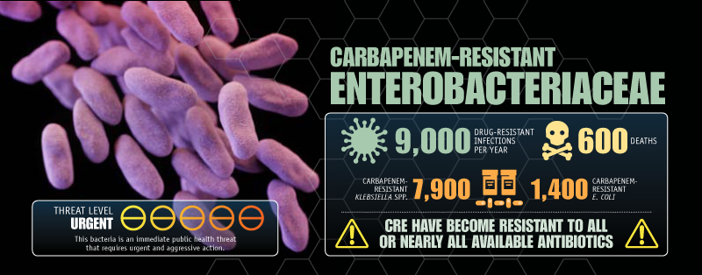


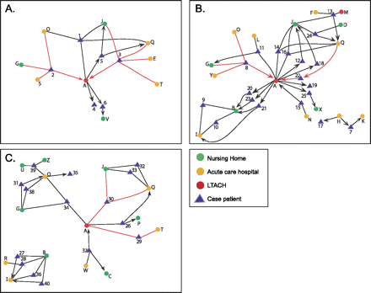
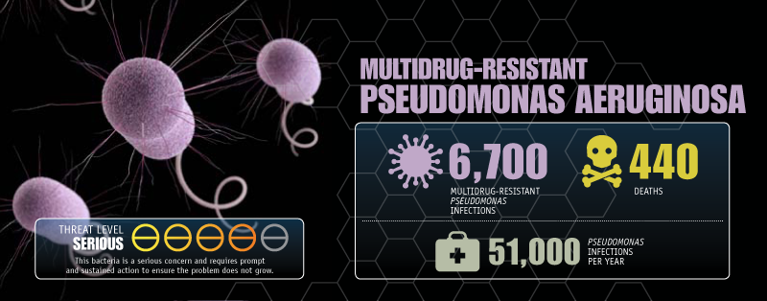
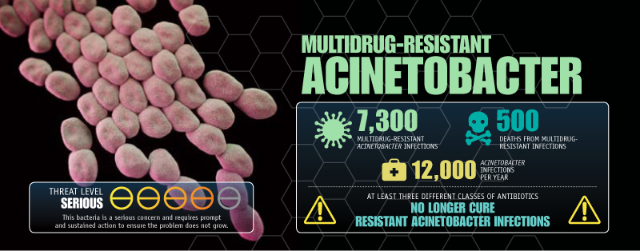
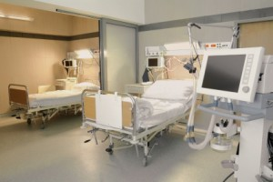

Characteristics of MDROs in PA/LTCFs
Resistance
Detection
Transmission
Spread
INFECTIONS
CRE
CRPA
Pan-resistant organisms
Candida auris
GENOTYPES
ASYMPTOMATIC COLONIZATION

Slide 30
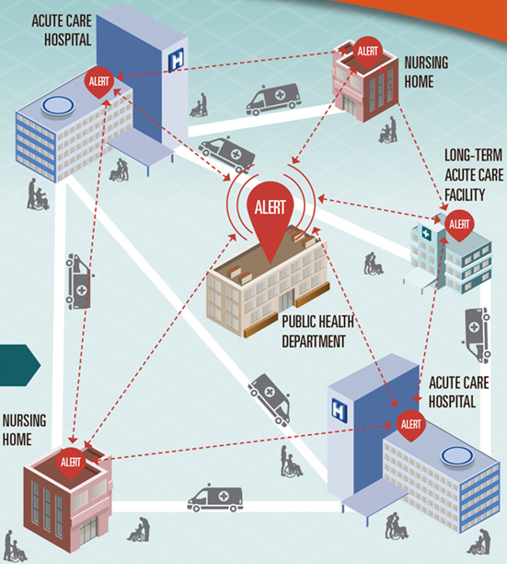



Containment and Prevention of MDROs

Slide 31
CDC Containment Strategy
Systematic approach to slow spread of novel or rare multidrug-resistant organisms or mechanisms through aggressive response to ≥1 case
  Pan-resistant organisms
  Carbapenemase-producing organisms
  mcr-1
  Candida auris
Response based on pathogen/resistance mechanism
https://www.cdc.gov/hai/outbreaks/mdro/index.html

