Slide 1
AHFSA Best Practices 2019 Using Technology to Drive Process Improvement
MARYLAND DEPARTMENT OF HEALTH
Office of Health Care Quality
Margie Heald, Deputy Director, Federal Programs
Ranada Cooper, Program Manager, Long Term Care
August 5, 2019

Slide 2
Problem Assessment
Program Types:
Long Term Care (LTC)
Residential Service Agency (RSA)
Issues:
With increased LTC Change of Ownership and RSA applications, issues with:
Communication
Processing

Slide 3
Program Goals
Revised application
Electronic tracking database
User-friendly electronic submission
Program-specific dashboard that serves as a resource center for the application and all program information
Notes:
For the both programs, the goals established included:
1. Revision of the agency’s current application form to decrease administrative burden on both sides;
2. Electronic tracking database that allows multiple staff simultaneous access to all documents and the concurrent completion of steps;
3. User-friendly electronic submission option for providers to submit documents; and
4. A program-specific dashboard that is a one-stop resource center for all application materials and program information.

Slide 4
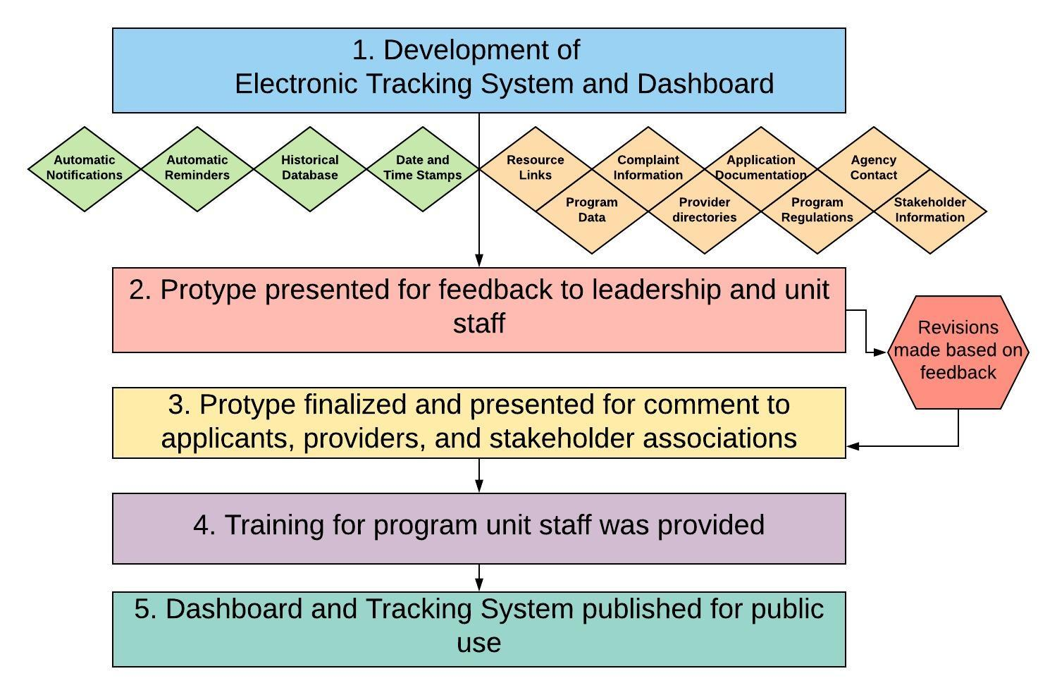
Implementation

Slide 5
Outcomes
Positive feedback from stakeholders, providers, and agency staff
Tracking system has allowed for an automated workflow with enhanced communication
Increased efficiency
More collaboration
Historical database
Easily accessible, wide
range of information
Improved work flow
Notes:
Extensive positive feedback from stakeholders, providers, and agency staff
The tracking system has allowed for an automated workflow for enhanced communication between the agency and providers
Increased staff efficiency
Higher collaboration levels
Provides a historical
database with activity logs
and date/time stamps
Easily accessible broad
range of information
Improved work flow and increased automated
communications

Slide 6
System Evaluation
Evaluation and feedback methods:
Bi-weekly application status updates
Quarterly performance and data meetings to review system
Daily informal staff meetings for feedback
Feedback form for providers
Feedback from advocates, attorneys, lobbyists, special interest groups, and other state agencies
Notes:
Evaluation and feedback methods include:
• Bi-weekly tracking of the status of RSA applications;
• Quarterly meetings to discuss system performance and program data; and
• Daily informal meetings with staff to gather feedback
Feedback form allows providers to give electronic feedback.
Feedback from lobbyists, special interest groups, and other state agencies

Slide 7
Innovation and Sustainability
Visually appealing and intuitive dashboard
Twenty-four hour secure cloud-based access on any device connected to the Internet
Enhanced communication
No Information Technology (IT) staff utilized
Systems are customized
Permission level controls
System improvements can be made within minutes
Notes:
Visually appealing and intuitive Dashboard
Twenty-four hour access to program information from any mobile device
Increased communication and use of technology
No Information Technology (IT) Staff were needed in the development or maintaining these systems
Systems can be customized based on provider type
Permission levels allows control of who is accessing information
System improvements can be made within minutes

Slide 8
Recommendations
Multiple software applications available
Pick a system that meets your agency’s needs
Consider timeframes and costs for training and implementation
Staff and stakeholder involvement
Focus groups, surveys, and face-to-face meetings

Slide 9
Demonstration
Long Term Care CHOW Dashboard Link:
https://app.smartsheet.com/b/publish?EQBCT=94a019649f3649e68af14c6f81fb25a7
Long Term Care CHOW Tracking System:

Slide 10
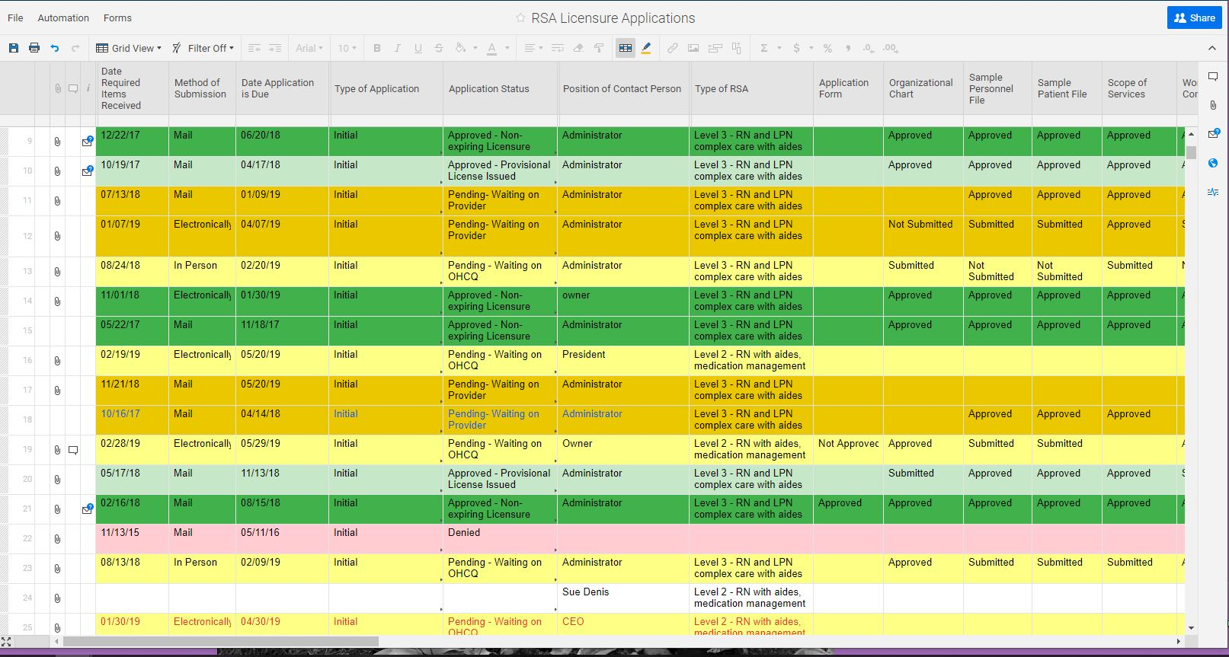
Demonstration
Residential Service Agency (RSA) Dashboard Link:
https://app.smartsheet.com/b/publish?EQBCT=85e22fc816cc4cc0a30f1b5a41f5146e
RSA Tracking System:

Slide 11
Questions
Margie Heald, Deputy Director of Federal Programs
410-402-8101
margie.heald@maryland.gov
Ranada Cooper, Program Manager, Long Term Care
410-402-8017
ranada.cooper@maryland.gov
Tricia Tomsko Nay, MD, Executive Director
410-402-8055
tricia.nay@maryland.gov

