Slide 1
AHFSA Annual Conference
Background Screening Interest Track
August 4-7, 2019
The Georgia Background Check Program The road to implementation. What’s next?
Denise Matthews , Georgia Department of Community Health

Slide 2
AGENDA OVERVIEW
Timeline
Georgia Long-term Care Background Check Program
Caregivers Registry
Rap Back
Provider Outreach
This Photo by Unknown Author is licensed under CC BY-SA-NC

Slide 3
Timeline
The Georgia Long-Term Background Check Program was introduced in the 2018 legislation session.
It expands Georgia’s current background check requirements, as well as the list of covered crimes that would:
1. Disqualify direct access employees from employment.
2. Owners from obtaining a facility license.
SB 406 is effective on October 1, 2019.

Slide 4
HIGHLIGHTS
Requires facilities to conduct a search of applicable public registries.
Expands Georgia criminal background check screening requirement: now requires a federal and state fingerprint-based criminal background check on all direct access staff and management working in certain facility types.
Expands the list of covered crimes
1. Owner
2. Director and Onsite Manager
3. Employee

Slide 5
Who is impacted?
On or before January 1, 2021, all existing owners, directors, onsite managers, administrators and direct access employees will be impacted.
New owners
New directors, onsite managers and administrators
New employees with direct patient access
The New Georgia law goes into effect on October 1, 2019.

Slide 6
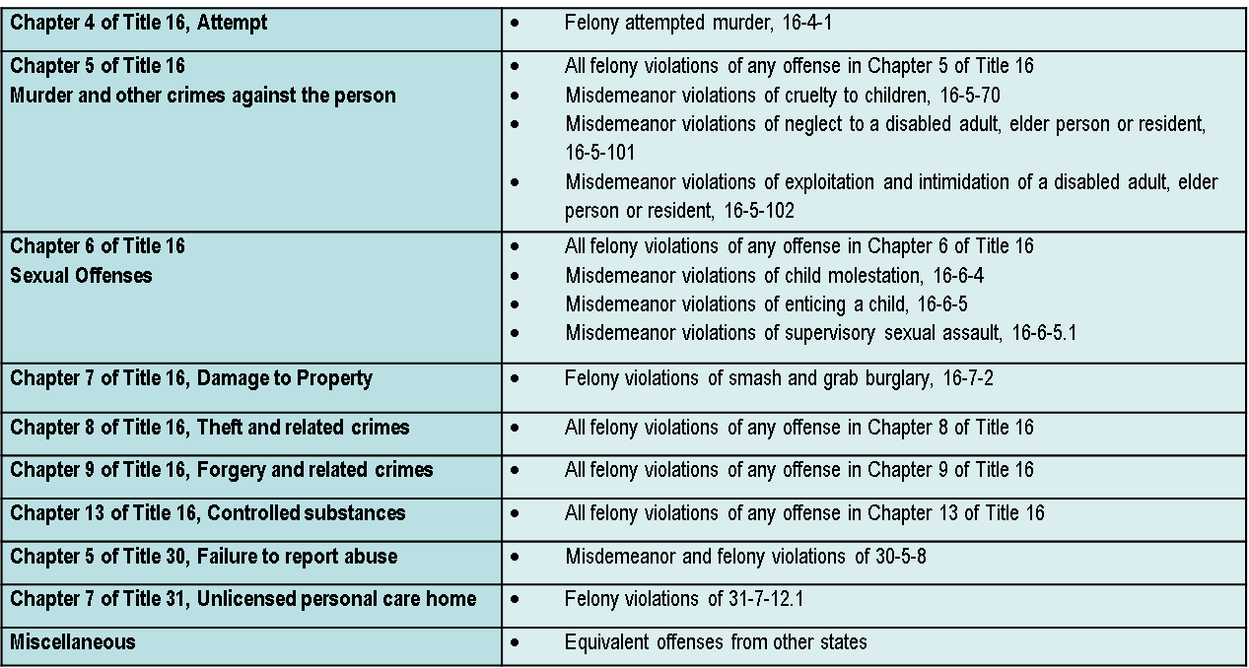
Covered Crimes
The purpose of the new requirement is to exclude individuals with a criminal record from working with vulnerable older or disabled adults. The look back period is 10 years. Disqualifying crimes are as follows:

Slide 7
Impacted Facilities
The Georgia Long-Term Care Background Check Program requires fingerprint-based criminal background checks of owners, applicants for employment, and direct access employees at the following long-term care facilities:
Adult Day Centers
Home Health Agencies
Hospices
Intermediate Care Facilities
Nursing Homes
Assisted Living Communities
Personal Care Homes
Private Home Care Providers

Slide 8
Registries
Georgia Professional Licenses
Certified Nurse Aide Registry
National Sex Offender Registry
Georgia Sex Offender Registry
The Federal OIG List of Excluded Individual & Entities

Slide 9
What’s next?
Licensure website updates.
Complete technical, background check system updates
Data imports; covered crimes, facility information
Provider training

Slide 10
Caregivers Registry
It’s new, and the first of its kind in Georgia.
Enables employers who are:
Family members, guardians of elderly persons 65+
To obtain an employment eligibility.
Private employers/family members can check the DCH public Caregivers Registry to determine if the applicant is satisfactory or unsatisfactory for employment in a residential setting.
A. Federal and state fingerprint-based criminal background check.
B. Requires registry checks.

Slide 11
What's next?
Licensure website update.
Build the applicant initiated website build and import; covered crimes
Community Outreach

Slide 12
Rap Back
SB 336 will implement a Rap Back process that would authorize certain Georgia state agencies that have oversight of vulnerable populations (e.g., disabled, children and/or the elderly) to voluntary participate in the Rap Back program.
SB 91 allows the Georgia Bureau of Investigation to retain fingerprints for purposes of the Georgia Long-term Care Background Check Program
Rap Back under construction by our state repository- GBI/GCIC.

Slide 13
Provider and Community Outreach
Informational webinars
Provider email blasts
Communications
Outreach presentations at the various provider and community associations
Updating the DCH websites
Update FAQs /other informational documents
Provider and community training
Onsite and offsite
Training videos

Slide 14
What's next?
Expanding the live scan machine and fingerprint services
System production and test server upgrade
System updates
Community and provider outreach
Provider onsite and offsite training
Caregivers registry is under construction

Slide 15
Questions from States?

